Slide 1
The Internet in everyday life
Purple Team

Slide 2
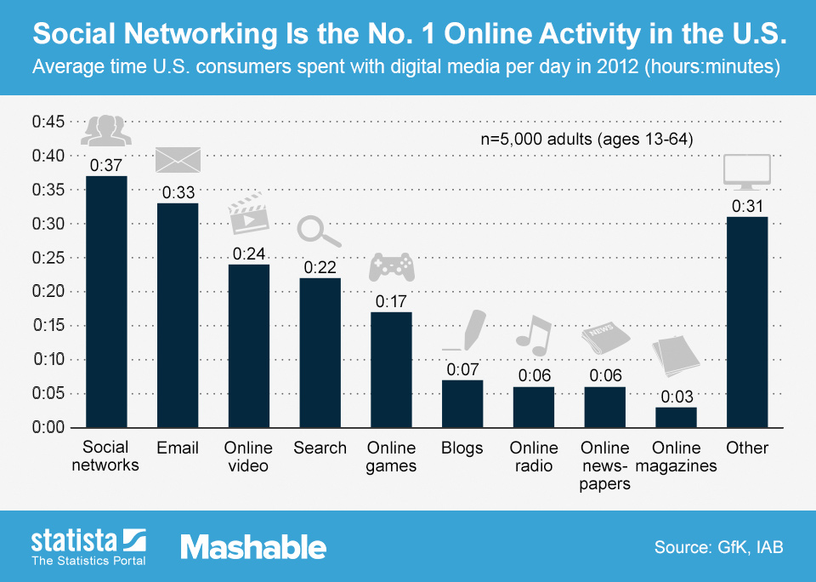
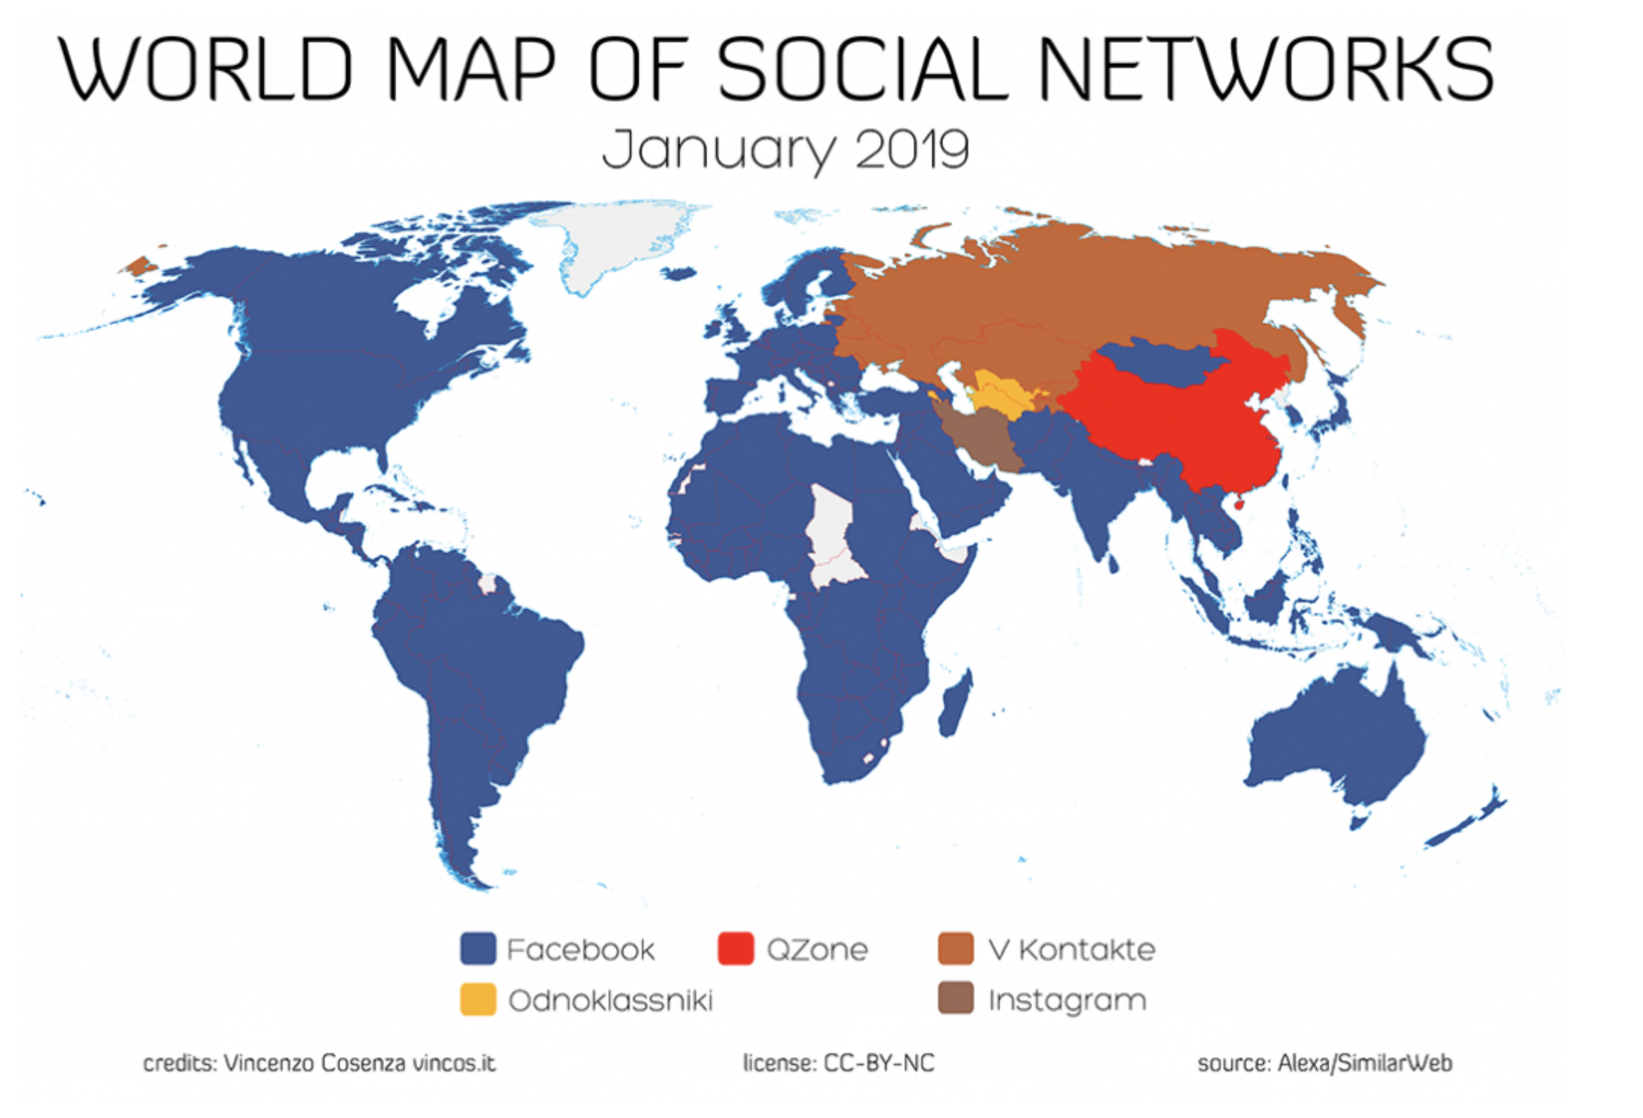
Sociability
Notes:
much of our online time, apart from looking for information, is spent socializing. No-longer via email but Facebook, Twitter. As author defined, online socializing is Interpersonal active mutual engagement
Currently, social media are used most intensively among younger and, in India and China, affluent urban populations. In Sweden and America, these differences will fade over time. Although, there are different social media platforms, there are similar patterns across the world.. Do social media shape our everyday life? Are there any common patterns?

Slide 3
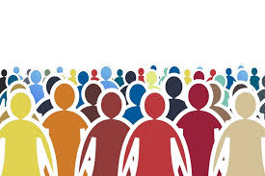
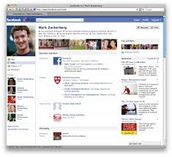
Tethered Togetherness
Sender : Selective self-presentation via text, image/video …
Facebook Page = Means of presenting the self
Receiver/Audience : Interprets the staged self by interaction
Often Asynchronous
Mediated Encounter
Audiences are active and the performer monitors the response by audiences
Notes:
What is online socializing? Social media is never one-way communication. Compare with face to face communication. They’re symmetric. Those people we display ourselves to are the audience. They’re both selective. Audience selectively monitor and respond.
The audience responds typically affirming that they agree with the how he presents himself. Performer cares about the audience response

Slide 4
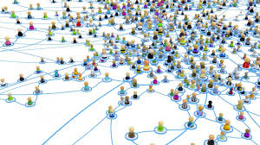
Tethered Togetherness
Weberian Cage but not “Iron Cage”
Social Media use constitutes Tethered Togetherness
Multiple Interdepencies between people in various different roles = Durkheim’s “Organic Solidarity”
Notes:
These encounters are also becoming routine or everyday rituals, tethering us more to each other

Slide 5
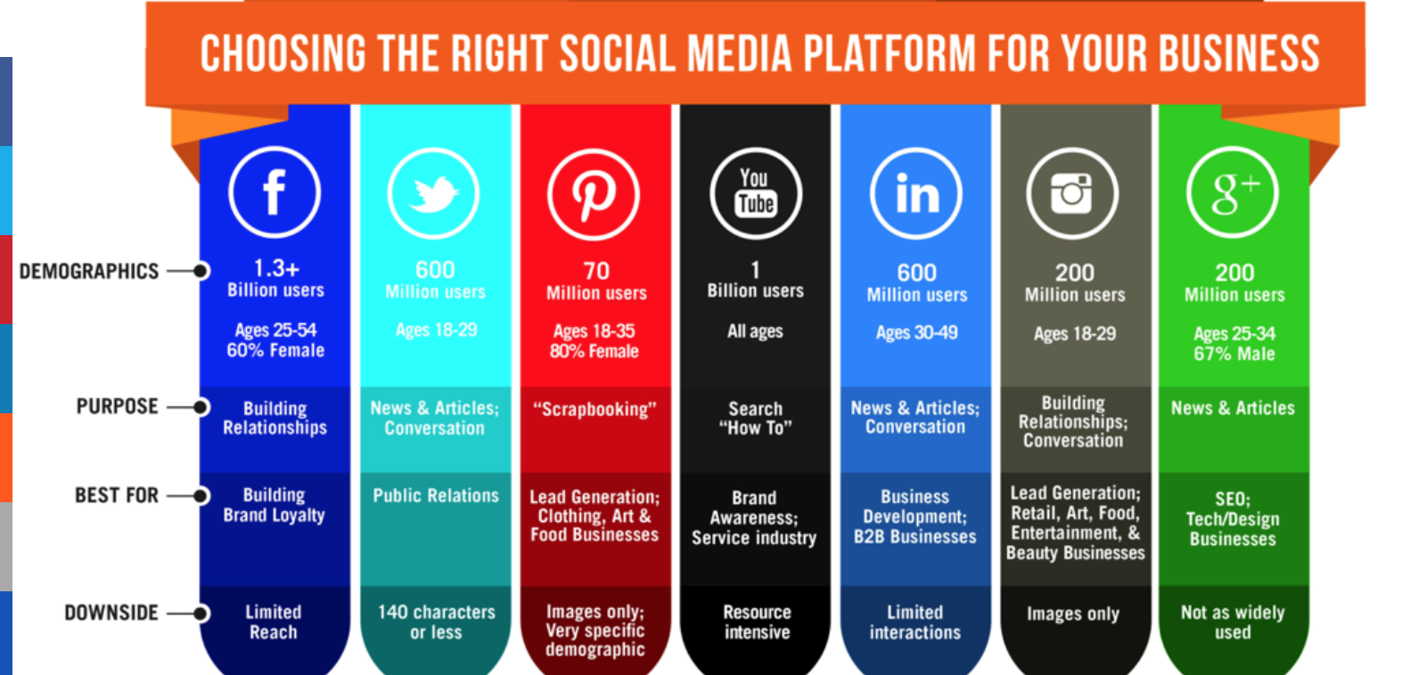

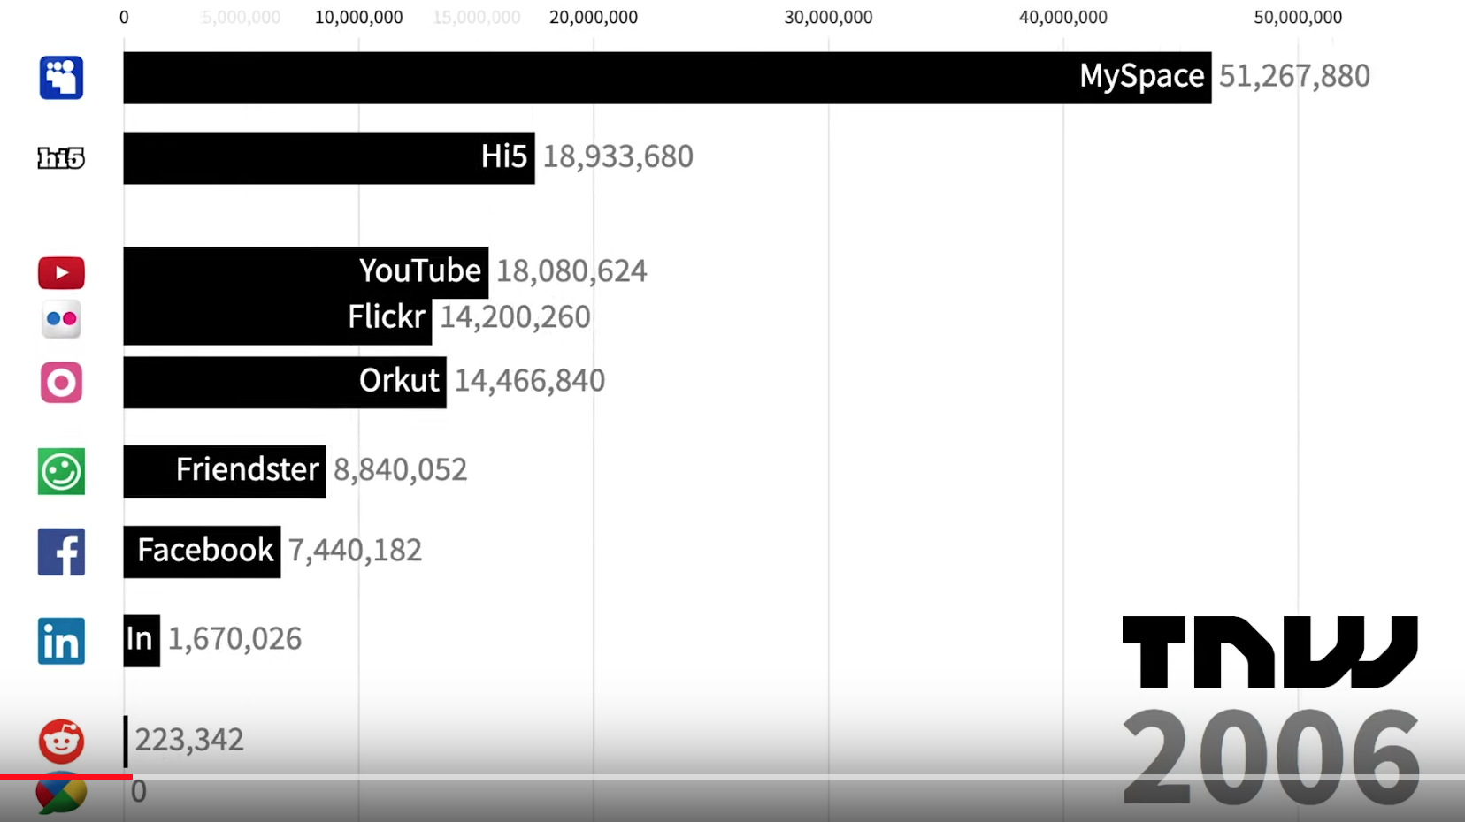

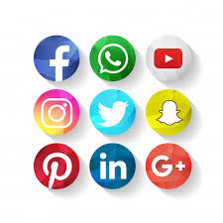

The Spread of Social Media
Always “ON”
Sources : jtvdigital, TNW
Notes:
New devices Not fully replaced but added as a complement to the existing communication tool. Social media added multimodality (text, voice, etc). Social media is becoming more differentiated.

Slide 6
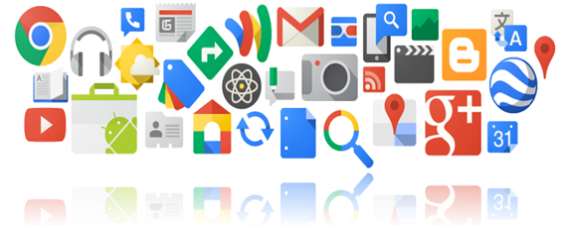
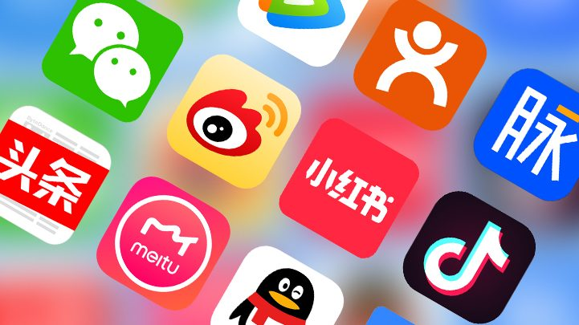
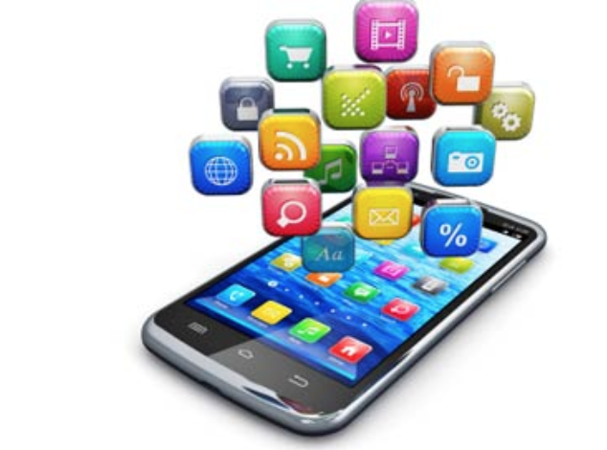
The Spread of Social Media
VS
Better OS
High powered cameras
Better battery life
Larger storage capacity
Better ways to use apps
Integrated AI (Siri)
Content is more differentiated
Different functionalities are combined on devices
Notes:
Greater differentiation leads to denser, more frequent and more multiplex or multimodal sociability
Companies want their platform as multi-modal as possible to lock the users. Google+, Youtube, different in China

Slide 7
The Spread of Social Media
Smartphone access to Internet disadvantages:
Small screen and keyboard
Few sites with less functionality
Slow download
Restricted to apps
Restricts ability to create contents
In India and China, smartphone is the most common way to access Internet.
! Data Plans Metered Mindset
Napoli and Obar (2015) - A major divide
Notes:
In India and China (of the countries discussed here), social media are commonly the first experience of the internet, via smartphones.
In Sweden and USA, most of the people use computer, other devices.

Slide 8
Sociability and Social Divides
Status seeking (selfish materialism, belonging)
Showing best or idealised versions of themselves,
Conforming to norms of social groups
What other finds of social divides are there?
Common across social media around the world (Miller)
Marwick
Groups on Social Media
“Manage Demands”
Hierarchy order of access
Capitalism requires entrepreneurial self to be fashioned
Age and Gender
Urban, Rural residents and Migrants
Young and old users
Notes:
Sociability is about belonging to groups. Status seeking, rather than being a sign of selfish materialism, can be seen as a sign of ‘belonging’, not just in consumerist capitalist societies but also in Asia. Marwick- Silicon Valley Companies pay extra attention to its online self-presentation.
According to Miller people need to arrange their social relations online, putting people into different groups on different social media platforms and organizing various kinds of relationships with them. It can be burdensome. It also creates offline hierarchy.
these urban youths post pictures of sport idols and cinema stars with whom they would like to be

Slide 9


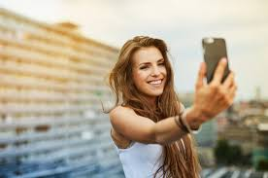



Visual Co-Presence
Visual contents are dominated by selfies
Narcissism?
Enable people with lower literacy to express themselves
Connected viewing
Closeness
Everyday togetherness
Visual social media reinforce cohesiveness but there are also divides
Notes:
Most social media users post pictures and many also post videos. Why ? The visual content is dominated by Selfies. Miller argues that it’s not narc,it’s just way of visual self-presentation. Depends on Culture (in England it’s more of group, directed at world at large ), types of social media, Where its shared, but ‘an intention to gain popularity and attention’ or for ‘seeking affection.
For photo sharing, Ito and Okabe (2005) therefore speak of ‘intimate visual copresence’, which points towards visual togetherness

Slide 10
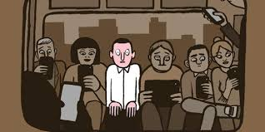
Alone or Together?
We learn less about ourselves and each other (Turkle)
Socializing online takes away from offline socializing is misleading (Miller )
We can learn more about each other in mediated environment (Walther)
Notes:
The increasing use of social media has prompted debates about whether being online is fragmenting society and isolating people. Many studies have found, however, that there has been no such decline in sociability. Survey show people report less loneliness overall and that people who use the internet ‘increase the volume of their meaningful social contacts. whereas books and TV could be seen as more asocial

Slide 11
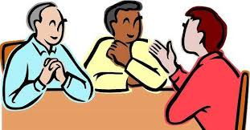
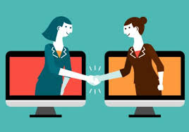
Alone or Together?
Both online (social media sociability) and offline interaction requires active engagement.
VS
Physical co-presence
Bounded by space
Large Crowd
Mutual attention is must
Shared moods can disperse over time
Notes:
Clearly online sociability is different from face to face encounters. In social media, unless mutual attention is paid, there is no bond or shared emotional
But episodic mediated interaction also sustains ties, and larger groups can equally sustain a shared mood,

Slide 12
Alone or Together
Social Media
Allows
Not limited to geographic distance
Frequent, Multiple interactions
Limited by
Size of sociable groups
Managing multiple interaction takes effort
Less focus on individual interaction
Audience may differ from expectation
Social media enhance
togetherness , unlike traditional mass media, they are not consumed passively.
Notes:
The moral panic or worry about a decline in togetherness is partly explained by attitudes to new technologies

Slide 13








Globalizing Sociability
Difference
Applications
Mobile-centric
Cultural content
Data plan
Similarity
Forms and types of content
Trend: more time, more diffuse
Cultural relativism

Slide 14
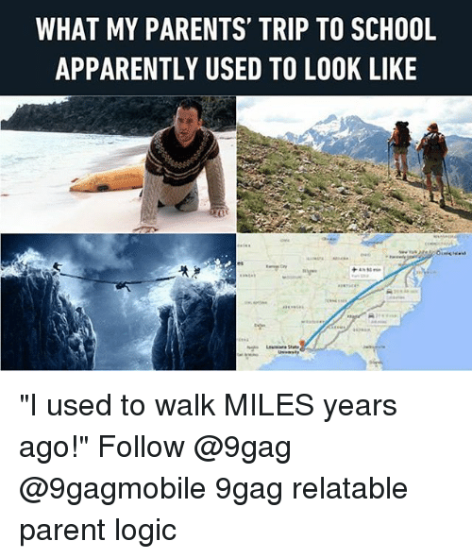


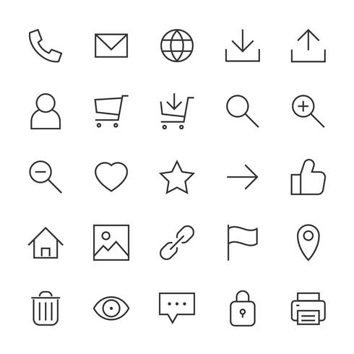
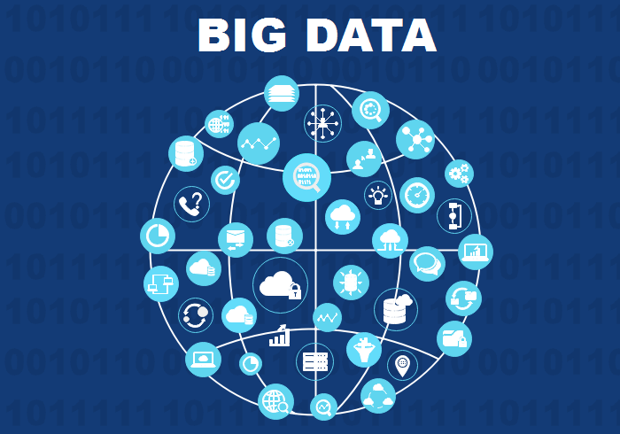

The Infrastructure of the Internet and Access to Information
Is Internet a Large System?
Physical Access to Print Media
Web
Apps
Why is the infrastructure important?
Is there a socio-political aspect to this?
Personal Assistants

Slide 15
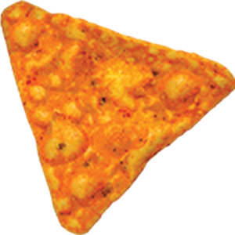
Some Triangles
Information
Information
Tailored Infrastructure
Democratic Infrastructure
Concerned People
Concerned People
Is internet and and the information on it essentially SCOT?

Slide 16
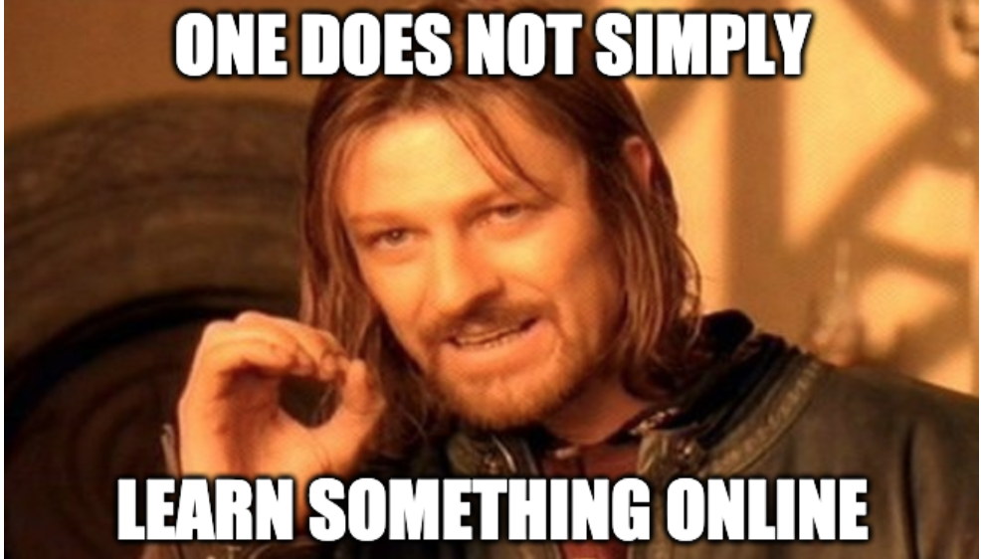
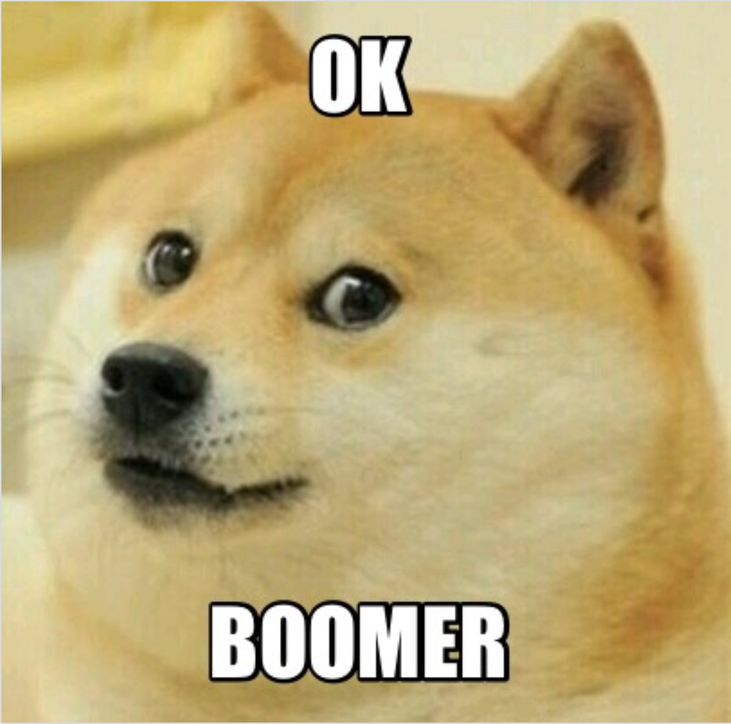
Access to Web-based Information
Information can be a result of “What?, Why?, Where?, How?, When?” etc
R Savolainen :
Necessary Information - Relates to human needs, crucial - WikiHow, WebMD etc
Non-serious Information - For leisure or consumption, luxury - Memes, Cat videos
Web- Accessibility Issues:
Web is a maze. Finding accurate sources can be difficult
Knowledge of how to use and understand interfaces can cause marginalization
Socio-political barriers like political restrictions (China), cultural taboos (Pornography)

Slide 17
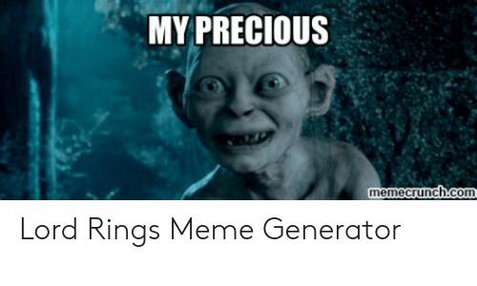
Seeking Information
Information can add value and power
Can help with decisions both individual and of the community
Can challenge traditional dogmas
Can provide authority
Domestication of the process:
Google receives 5.6 billion search requests a day. (+1)
293.6 billion emails sent per day. (45-60% are spam and from canvas)

Slide 18
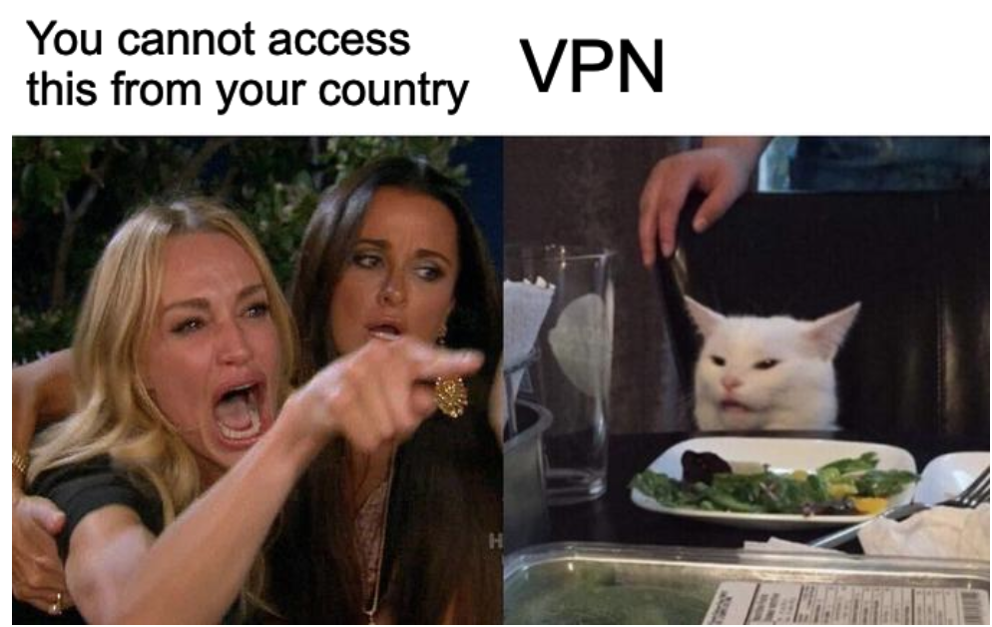
Is Web Global?
User generated information is a large part of the web. Does that mean it is purely democratic?
Can you think of ways institutions place restrictions?
There are billions of websites on the web. However, only 1000 of them have about 99% of the total web visits.
The problem of shared language can limit the usage of several sites.

Slide 19
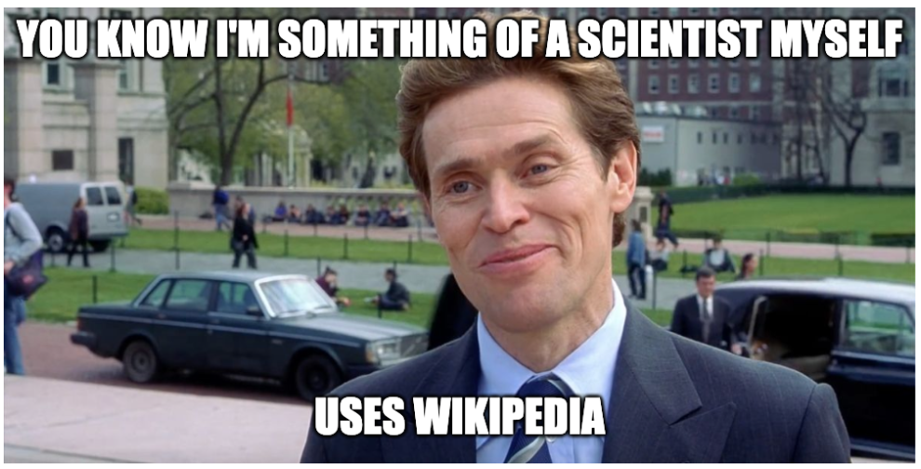
Wikipedia
One of the most used Information website (among the top 10 websites globally) Available in multiple languages
600,000 search queries that took users to Wikipedia, at least 400,000 appear only once.
38% sought popular culture topics
Majority of information obtained from Wikipedia is Non-serious
Trust? Accuracy?
Websites from government agencies, consumer organizations, hospitals, nongovernmental organizations, professional associations, and universities including Wikipedia demonstrated low credibility standards, provided mostly inaccurate information, and lacked comprehensiveness across all types of LBP. Our findings highlight the need for these organizations to reformulate their treatment recommendations to reflect current evidence in the management of LBP.
“Credibility, Accuracy, and Comprehensiveness of Internet-Based Information About Low Back Pain: A Systematic Review” - G. Ferriera (2019)

Slide 20
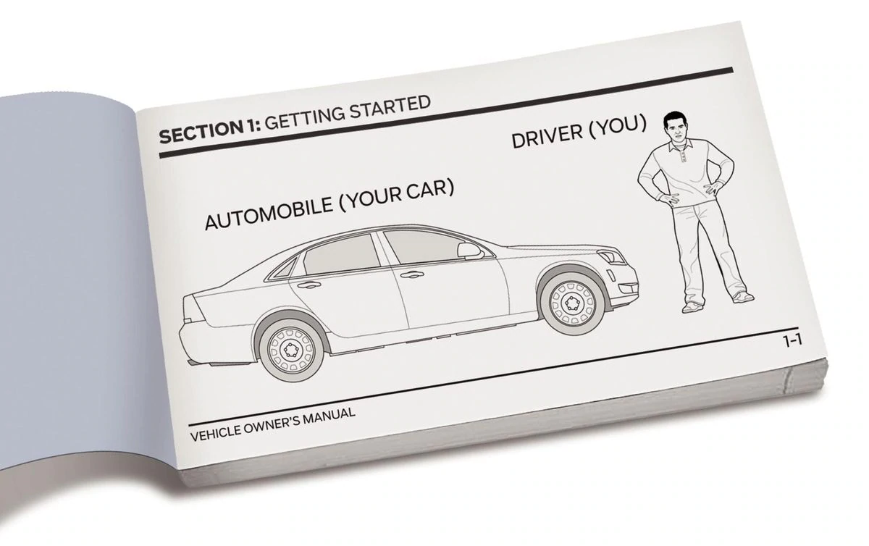




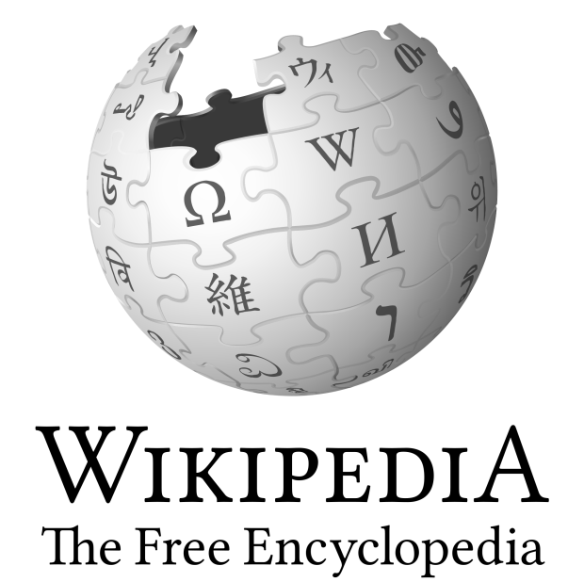
Accuracy vs Democracy
We believe that information can get less accurate if its more democratic. Information when controlled by a single organization or entity is more accurate due to the responsibility and backlash of producing misinformation
Autocratic
Low Credibility
High Credibility
Democratic

Slide 21
Question: Where Do Search Engines Fit In?
Autocratic
Low Credibility
High Credibility
Democratic

Slide 22
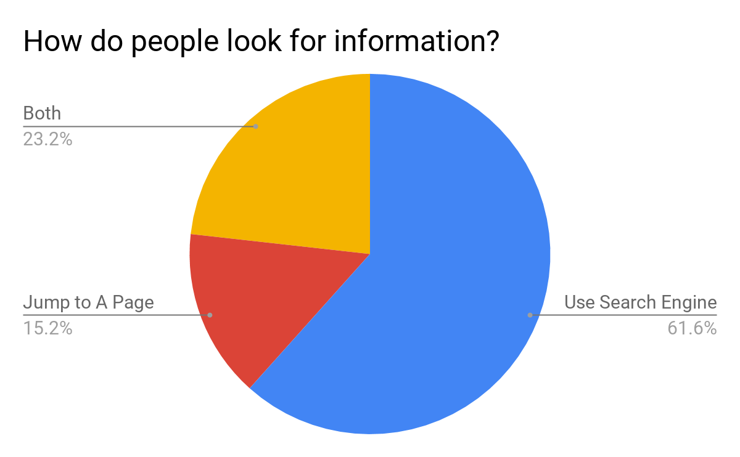
Search Engine Uses
Other interesting facts:
Around 50% of all search queries are to find a specific website
Conclusions:
Search engines are widespread
Only partly for information seeking
Notes:
queries about popular culture and Ecommerce account for almost half of all search engine queries. Somewhat surprisingly, the distribution of topics of search query did not vary significantly across different Lifestyle groups for the broad subjects of popular culture, Ecommerce, cultural practice and adult’ (2011a, 767).

Slide 23
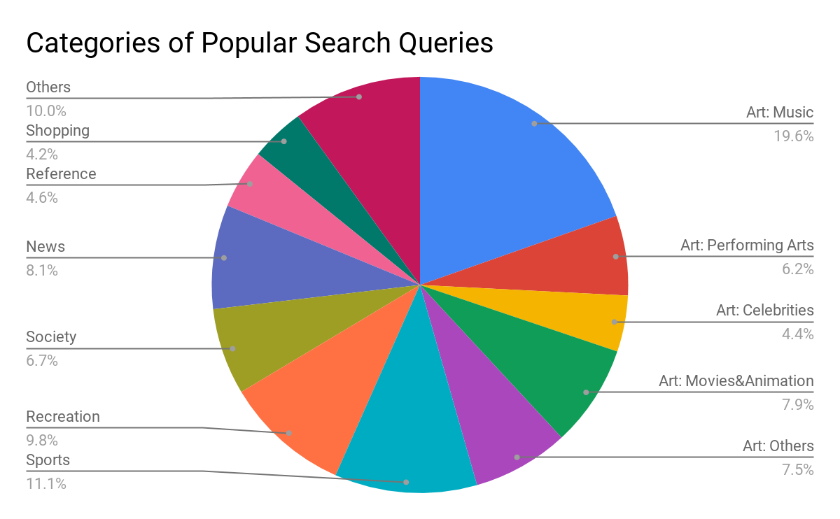
Search Engine Uses
Other interesting facts:
Around 50% of all search queries are to find a specific website
Distribution of topics of search queries don’t depend on social groups
Conclusions:
Search engines are widespread
Only partly for information seeking
A technology mainly for leisure or consumption
Notes:
queries about popular culture and Ecommerce account for almost half of all search engine queries. Somewhat surprisingly, the distribution of topics of search query did not vary significantly across different Lifestyle groups for the broad subjects of popular culture, Ecommerce, cultural practice and adult’ (2011a, 767).

Slide 24
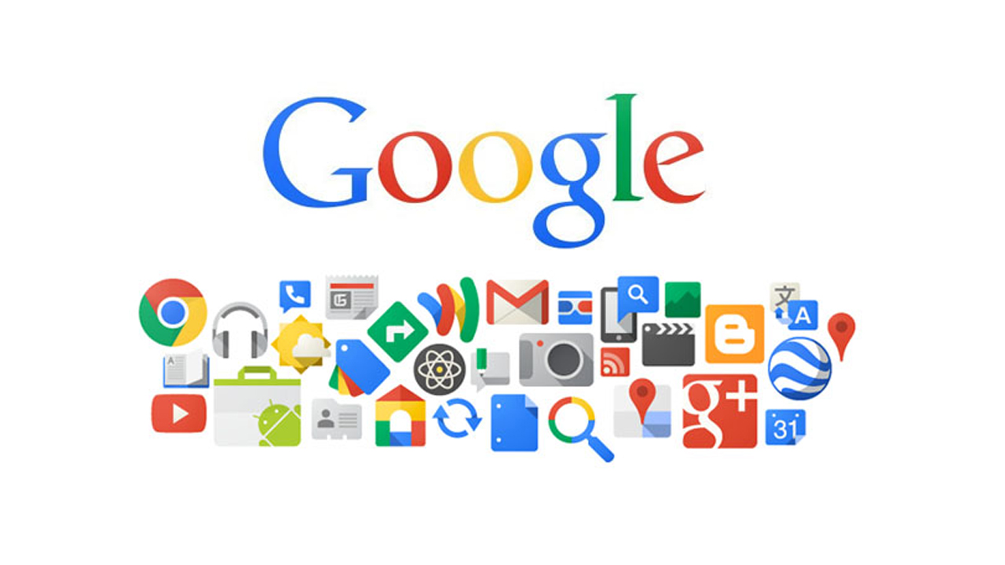
Characteristics of Search Engines
Shared characteristics: (with other technological systems)
Increasingly entangled with social forces.
Unique characteristics:
Rely less on hardware, more on software component
“Invisible”
Rely on billions of users’ searches

Slide 25
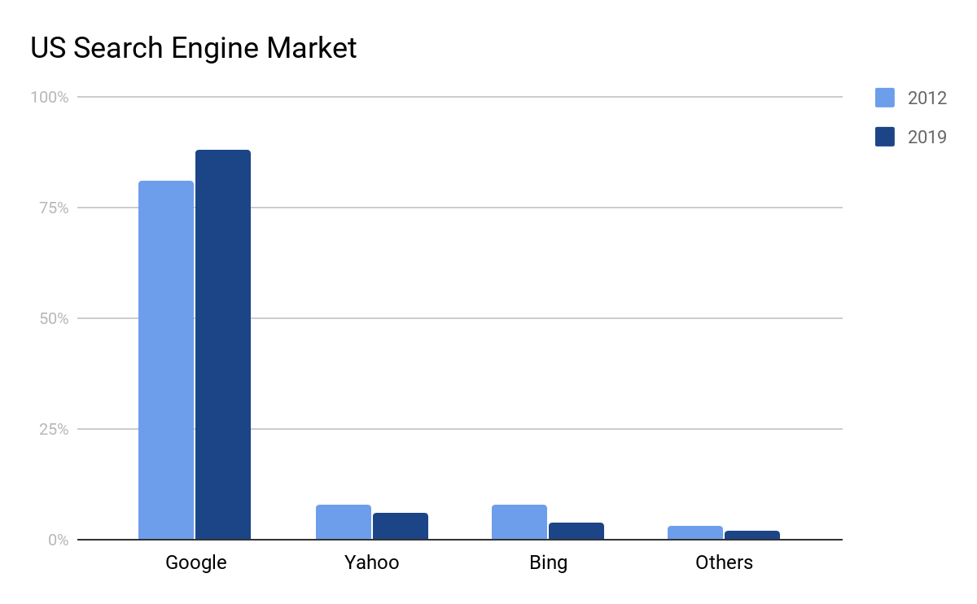
Search Engines As Gatekeepers
Google As the Gatekeeper
Google Shapes What We Know
A different Gatekeeper:
The whole infrastructure of the Web is available to everyone
Google provides little content

Slide 26
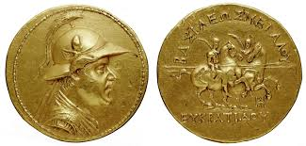
The Autocracy/Democracy Google
Autocracy
The algorithm is not transparent
Web is a public place, not Google’s own
Sponsored results are at the top
Democracy
The algorithm is neutral
A click to one web counts as a “vote”
Sponsored results are separated
Google’s dominant position is based on users’ contribution
Use of Google reinforces its dominant position
Notes:
It is important not to exaggerate the significance of monopoly and auto-demo-cracy: Google does not, for the most part, control content. Besides, Google is aware of the fact that its position is based on users, and the users start to become suspicious

